Slide 1
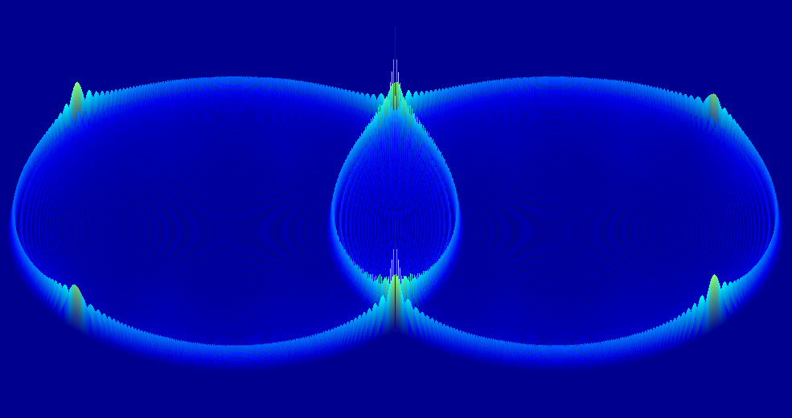

Quick March
The Sparse Finite-Different Time-Domain Method for Acoustic Modelling
Simon Durbridge
Dept. Engineering, Computation & Mathematics
University of Derby
Derby
UK
Notes:
Welcome to my talk about sparse acoustic finite difference time domain
Next: what is acoustic modelling for?

Slide 2
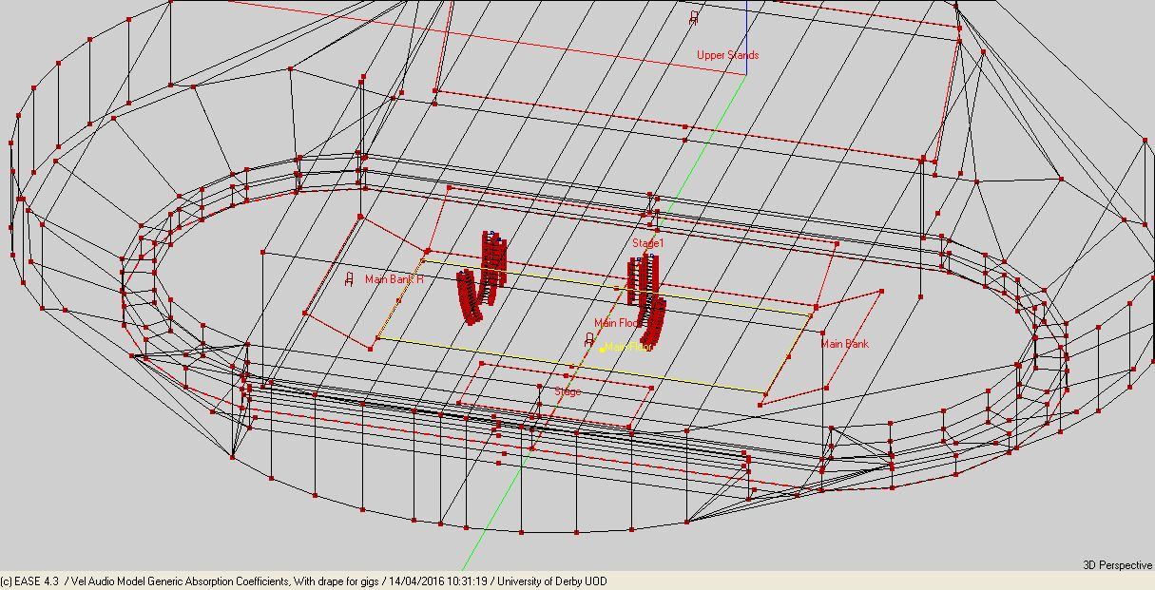

Acoustic Modelling
Purpose
Investigative Modelling
Rooms
Loudspeakers
Transducers
Acoustical properties analysis
Frequency Response
Decay Time
Occlusion
Modal Behavior
Auralization
Methods
Ray (statistical)
Geometric (FEM, BEM, FDTD etc.)
Hybrid
[1-3,7]
Notes:
What Model?
What Methods?
Ray Tracing
You need lots of rays in large spaces.

Slide 3
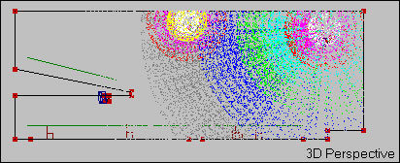
Ray-Tracing
Fire n ‘rays’ from point A
See how many boundaries the ray hits
Measure the reflections at a receiver point
Use time of flight to calculate impulse response
Can intuitively handle
some scattering
frequency dependent boundary absorption
frequency specific loss over distance
source directivity
Cannot handle low frequency behaviour
May require a significantly large number of rays
A more geometrically complex model may take a lot longer to compute
[1]
Notes:
Ray Tracing

Slide 4
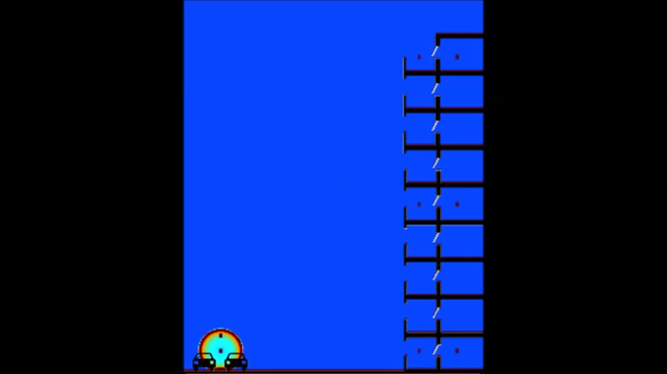
Finite Difference Time Domain Method
[6]

Slide 5
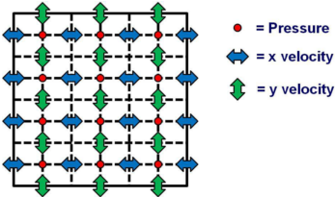





Finite-Difference Time Domain
$$u_{x+\frac{∆x}{2},y}^{x}\left(t+\frac{∆t}{2}\right)=u_{x+\frac{∆x}{2},y}^{x}\left(t−\frac{∆t}{2}\right)−\frac{∆t}{ρ∆x}[p_{x+∆x,y}\left(t\right)−p_{x,y}\left(t\right)]$$
$$u_{x,y+\frac{∆y}{2}}^{y}\left(t+\frac{∆t}{2}\right)=u_{x,y+\frac{∆y}{2}}^{y}\left(t−\frac{∆t}{2}\right)−\frac{∆t}{ρ∆y}[p_{x,y+∆y}\left(t\right)−p_{x,y}\left(t\right)]$$
Update Velocities
Update Pressures
Insert Source
Check Parameters
Display Data
$P_{x,y}\left(t+∆t\right)=P_{x,y}−\frac{c^{2}ρ∆t}{∆x} [u_{x+∆x}\left(t+\frac{∆t}{2}\right)−u_{x−∆x}\left(t+\frac{∆t}{2}\right)]$ $−\frac{c^{2}ρ∆t}{∆y} [u_{y+∆y}\left(t+\frac{∆t}{2}\right)−u_{y−∆y}\left(t+\frac{∆t}{2}\right)]$
+$\frac{∆t}{2}$
+$\frac{∆t}{2}$
2nd order in space
1st order in time
[4]
Notes:
FDTD works this way, the math example is 2 dimensions, the graphical example is 2 dimensions.

Slide 6

FDTD HAS SOME PROBLEMS
ACOUSTICALLY LARGE SPACES ARE A PROBLEM!
THERE IS TOO MUCH DATA TO PROCESS!
IT IS DIFFICULT TO COMBINE HYBRID DATA SETS!
SIMPLISTIC SCHEMES HAVE SIGNIFICANT ERROR!
[2-7]
Notes:
Method requires full discretization of the domain
Fine grid spacing required for high frequency modelling
Higher Order Schemes required to minimize numerical dispersion
Very difficult to implement non-rectilinear grids
Solving takes a very long time for large problems
even if parallelised

Slide 7

ALL IS NOT LOST
SPECTRAL FDTD SOLVER
GPGPU CAN MAKE FDTD SOLVING FASTER
HYBRID RAY TRACING & FDTD
[2,4]
Notes:
You can do spectral fdtd solving using fft
You can parallel up on a gpgpu
You can hybridize

Slide 8
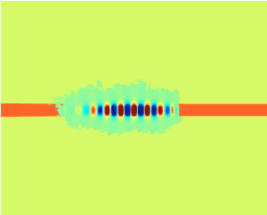
Sparse FDTD
Dynamic Windowing
Predetermine Windowed Area
Active energy listening
Calculate only areas where energy is appropriately high
Follow Shortest Paths Per Reflection
Dynamic window follows ‘on axis’ shortest bath between boundary nodes
Post-process multiple passes for waveform interactions
[5]

Slide 9

Questions?
Simon Durbridge
Dept. Electronics, Computing & Mathematics
University of Derby
Derby
UK

Slide 10

1. Elorza DO (2005) Room acoustics modeling using the ray- tracing method : implementation and evaluation. University of Turku
Mourik J Van, Murphy D (2013) Geometric and wave-based acoustic modelling using Blender. AES 49th Int Conf Audio Games 1–9.
3. Hill AJ (2012) Analysis , Modeling and Wide-Area Spatiotemporal Control of Low-Frequency Sound Reproduction.
4. Angus JAS, Caunce A (2010) A GPGPU Approach to Improved Acoustic Finite Difference Time Domain Calculations. 128th Audio Eng. Soc. Conv.
Doerr C (2013) Sparse Finite Difference Time Domain Method. IEEE Photonics Technol Lett 25:1–1. doi: 10.1109/LPT.2013.2285181
Jones C FDTD - Road Noise into Apartments with Balconies (Section View) - YouTube. https://www.youtube.com/watch?v=2YMDHTn-j7c. Accessed 24 Oct 2016
Durbridge S (2016) Improvements in Acoustic Modelling for Analysis & Auralization. Derby
IMAGES BY SLIDE NUMBER
http://www-users.york.ac.uk/~so523/WASPAA_Results.html/
https://i.ytimg.com/vi/eOBoKxEcVAA/maxresdefault.jpg
http://ease.afmg.eu/index.php/reflection-pattern-studies-with-ray-tracing.html
http://www.adamjhill.com/
http://www.cinemablend.com/television/Rick-Morty-Season-3-Premiere-Way-Sooner-Than-Expected-123037.html
https://i.ytimg.com/vi/eOBoKxEcVAA/maxresdefault.jpg
http://cdn.breathecast.com/data/images/full/33863/master-rick-and-morty.jpg
http://www.vulture.com/2015/09/rick-and-morty-universe-comprehensive-list.html
Notes:
References

